Slide 1

Notes:
1

Slide 2

Notes:
1

Slide 3

Notes:
1

Slide 4
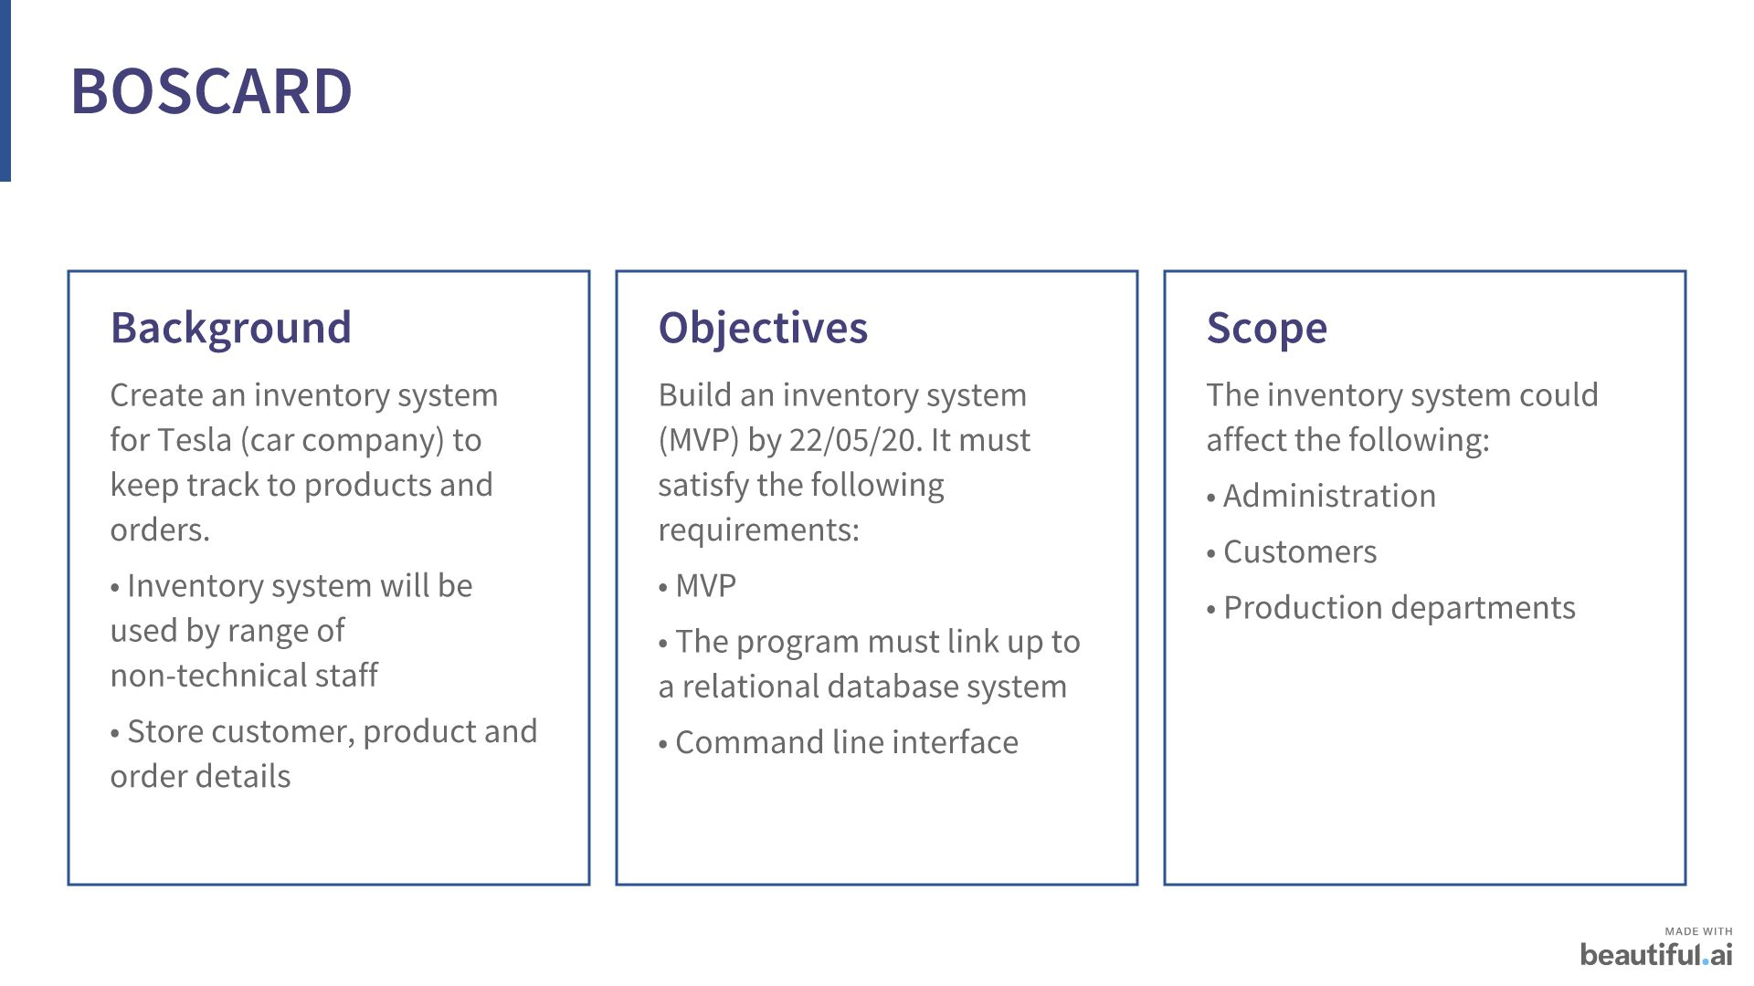
Notes:
1

Slide 5
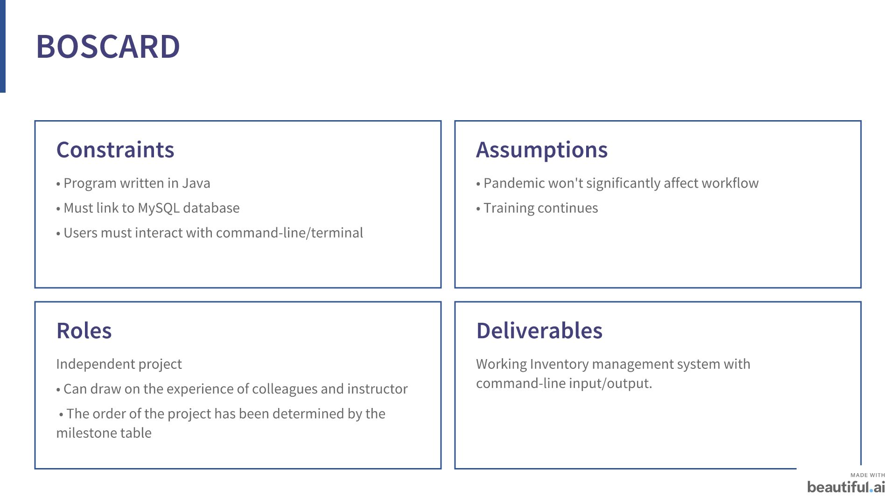
Notes:
1

Slide 6

Notes:
1

Slide 7
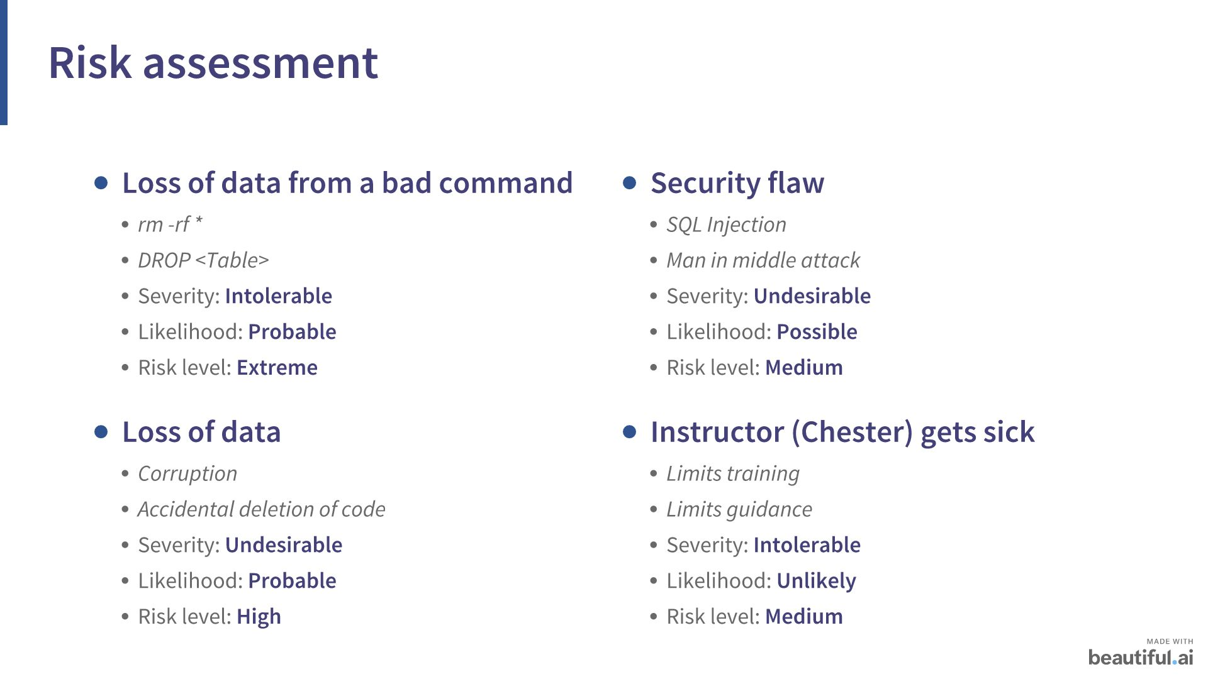
Notes:
1

Slide 8
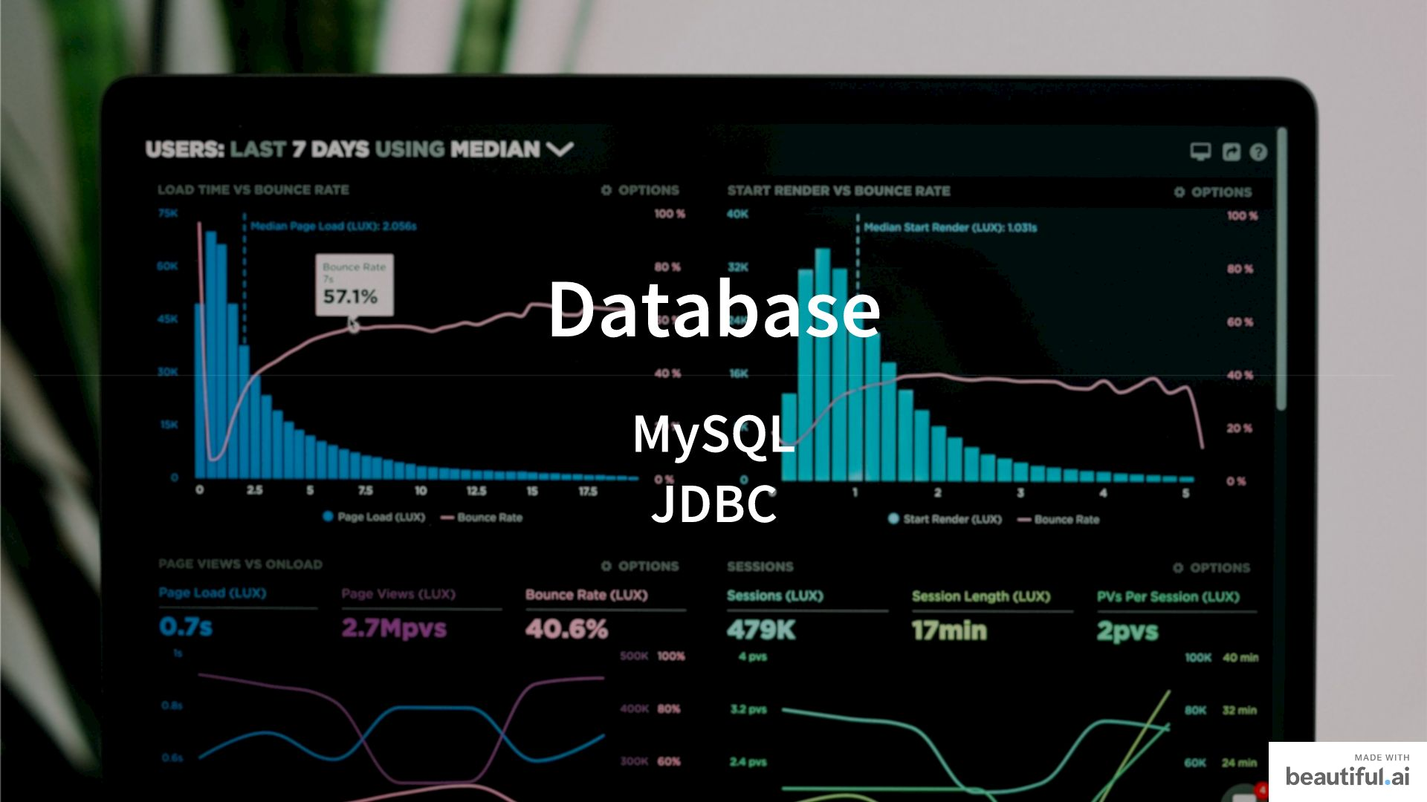
Notes:
1

Slide 9
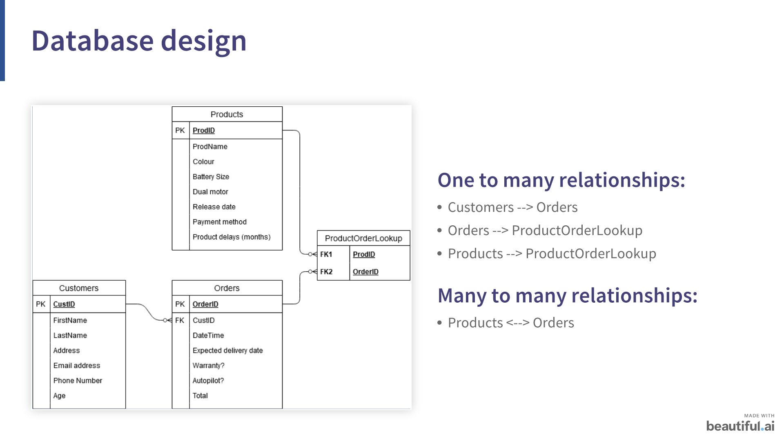
Notes:
1

Slide 10
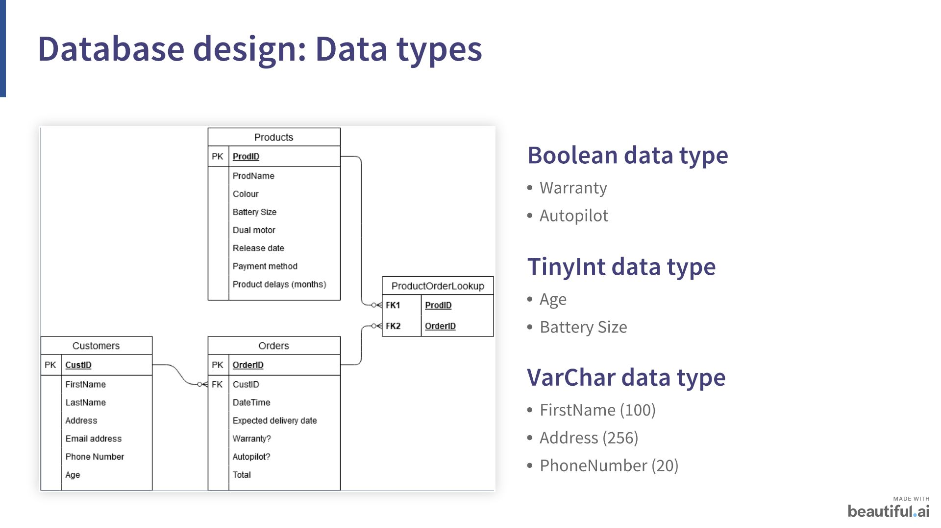
Notes:
1

Slide 11

Notes:
1

Slide 12
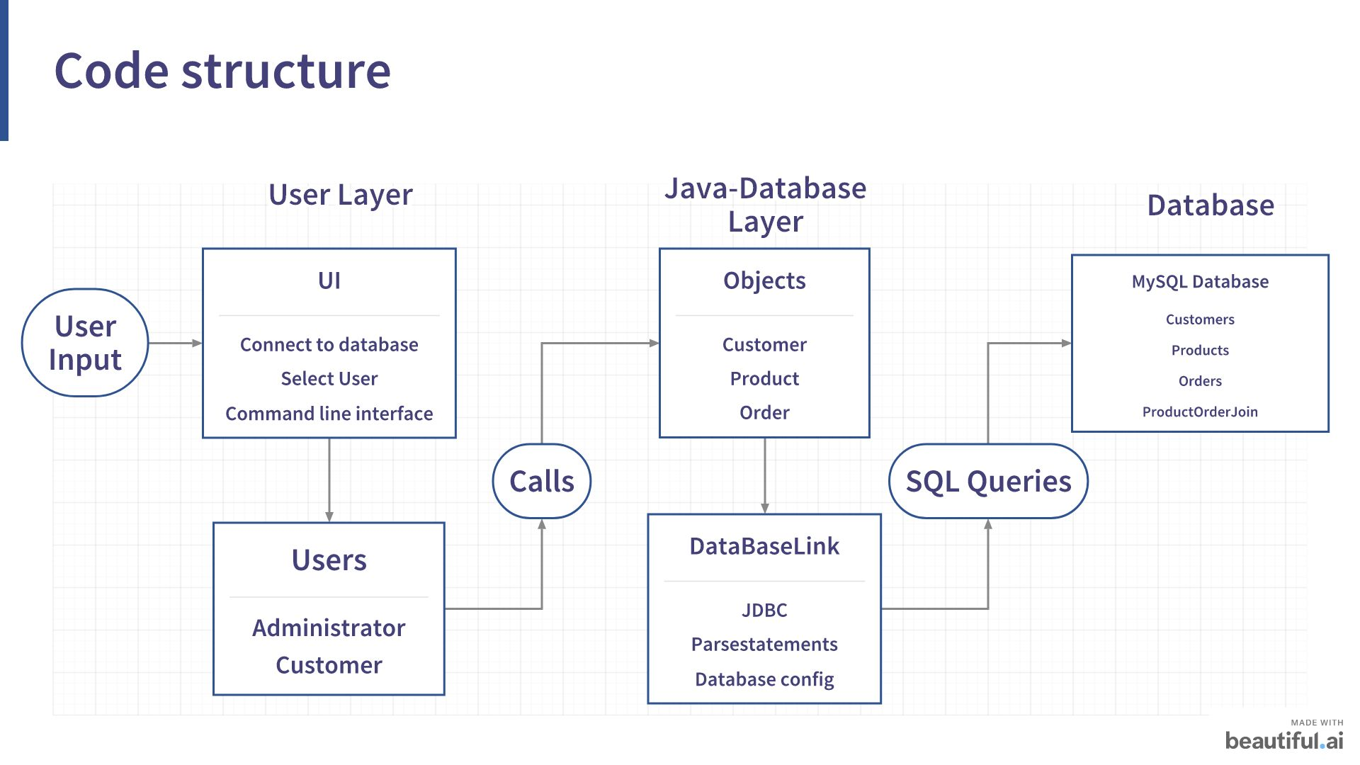
Notes:
1

Slide 13

Notes:
1

Slide 14
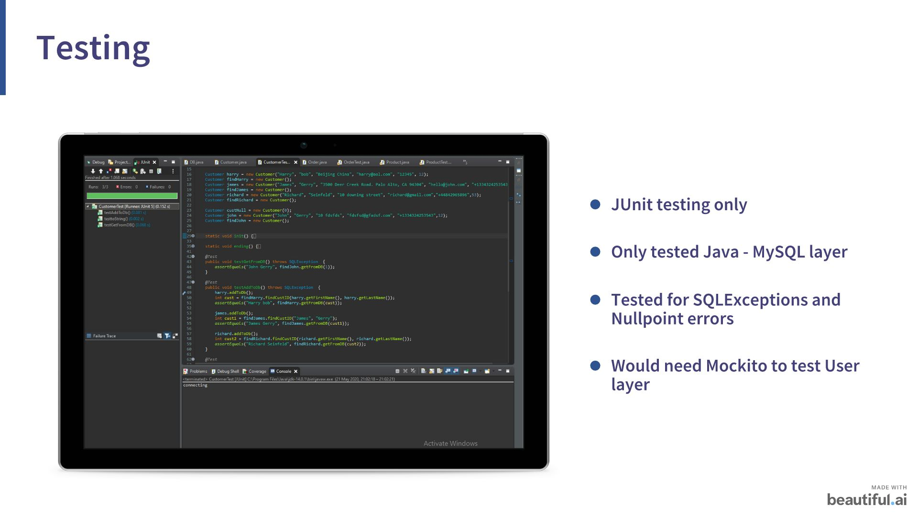
Notes:
1

Slide 15
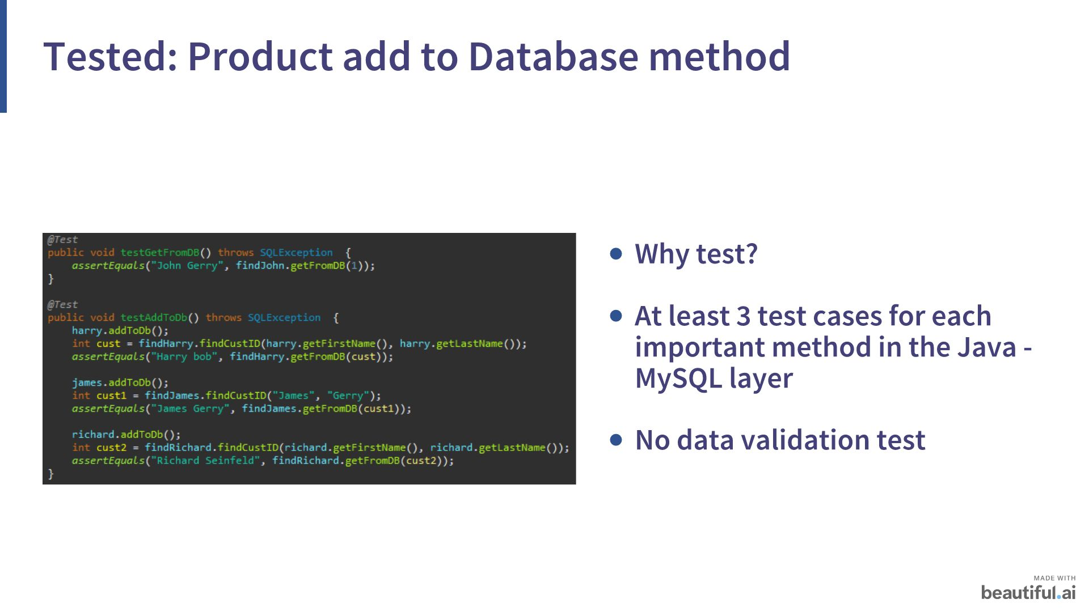
Notes:
1

Slide 16
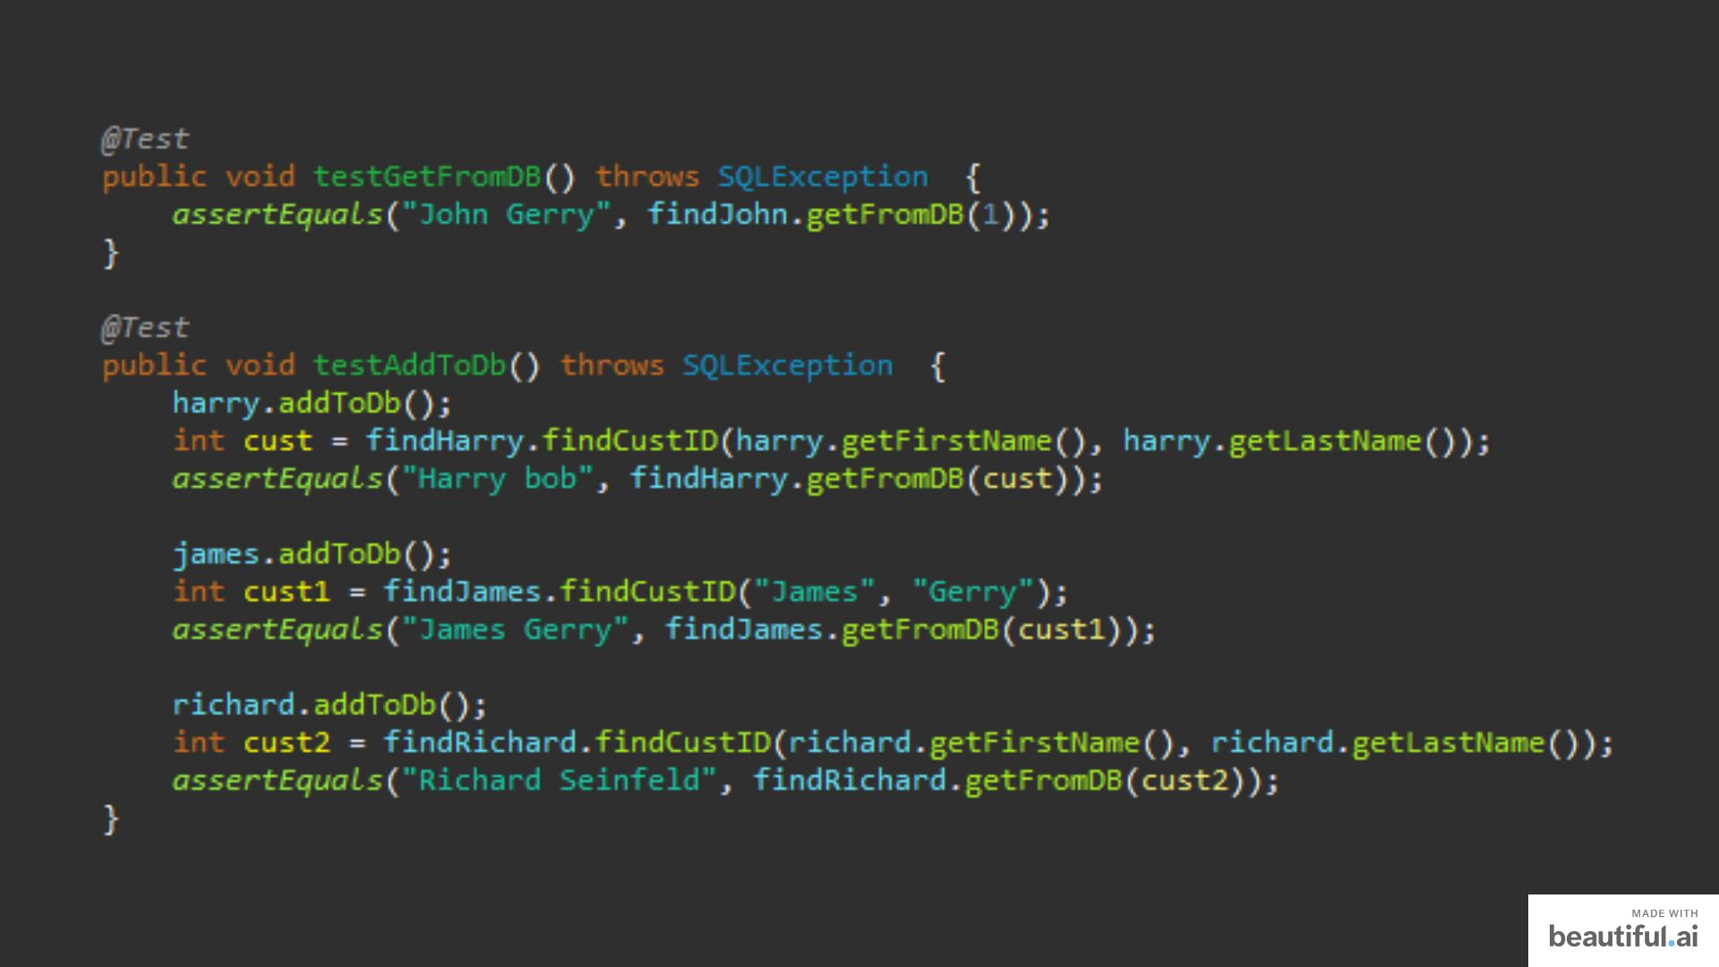
Notes:
1

Slide 17

Notes:
1

Slide 18
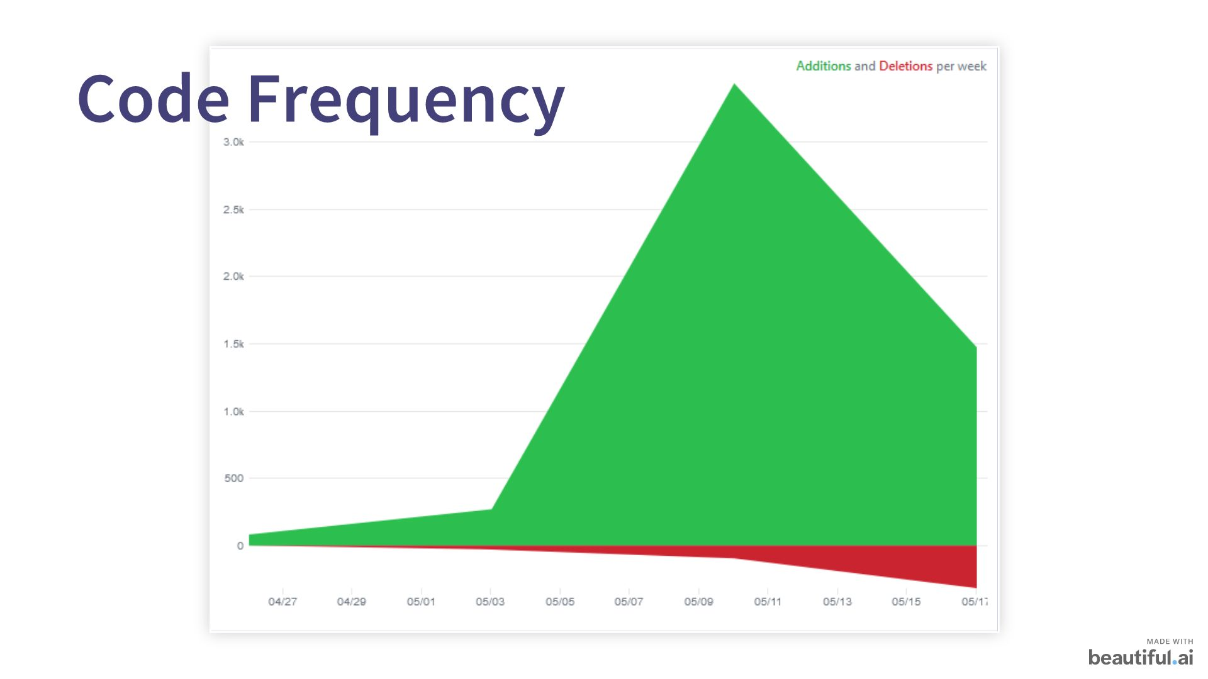
Notes:
1

Slide 19

Notes:
1

Slide 20
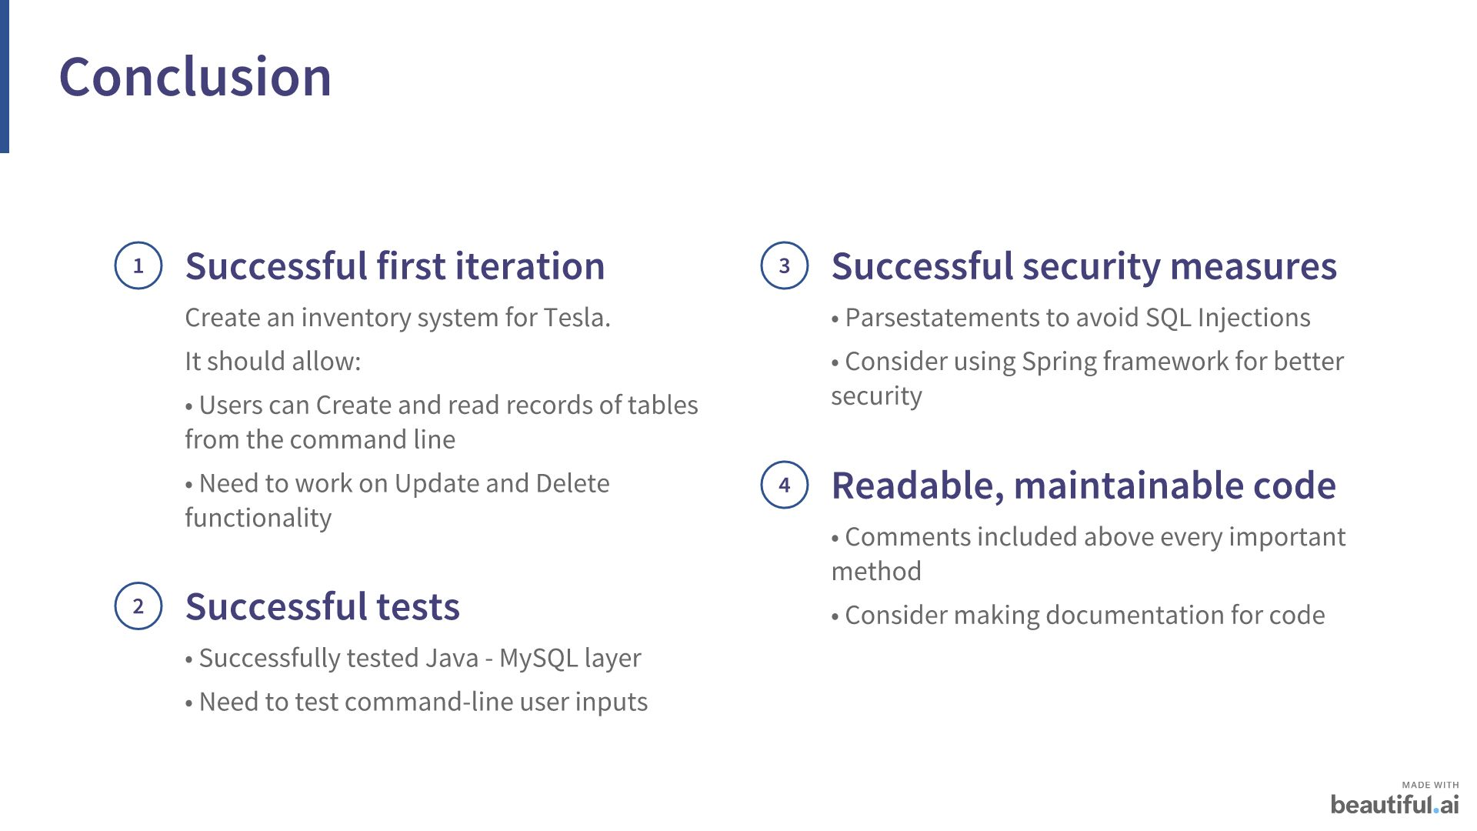
Notes:
1

Slide 21
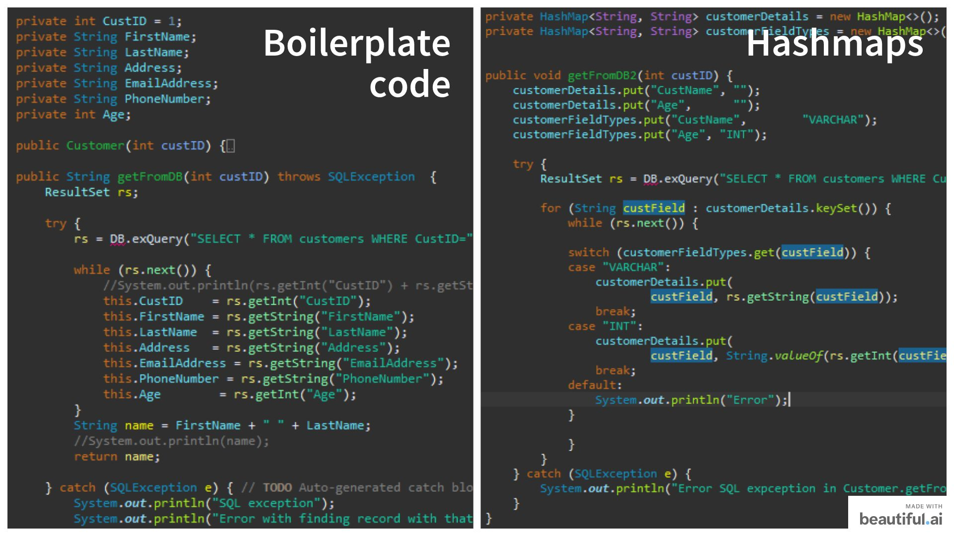
Notes:
1

Slide 22
Notes:
1

Slide 23

Notes:
1

Slide 24
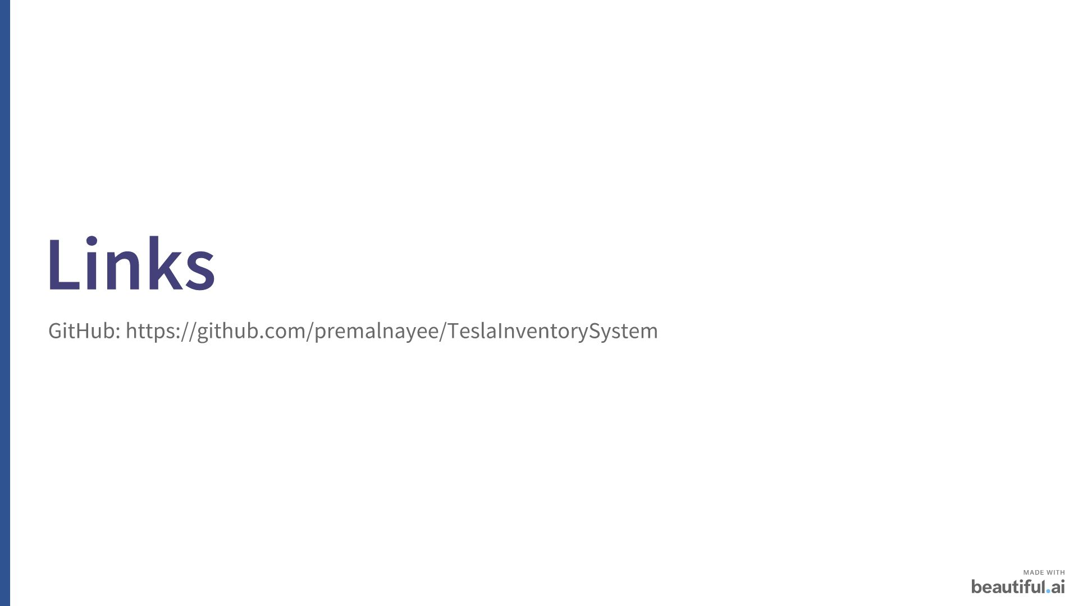
Notes:
<number>

